Slide 1
The Database for International Students' Education in the U.S.
Group members :Lahari, Prasanna, Ruby, Ting-Yu

Slide 2
Introduction
The International Students’ Predicament
Each year, hundreds of thousands of international students face challenges in finding suitable higher education programs in the US. Existing college search engines lack detailed international student-specific information making the process tedious and inefficient. The chances of overlooking suitable school is high. A centralized database needed for efficient search and match process, aiding in time and money allocation.

Slide 3
The Solution
Our unique and comprehensive database simplifies information management for international students applying for schools in the USA. It makes gathering and evaluating details related to schools, departments, programs, courses, and admission requirements easy and efficient. It allows for students to input their information as well as programs of interest and returns a list of fitting programs. The database allows for quick access to essential data, simplifying the educational journey for international students and assisting them in finding suitable schools in the USA.
Mission Statement
Our objective is to help international students succeed in finding their ideal school in the United States. By aggregating all information that would be important to an international student into one place it will help with application strategy and reduce the chances that the student will miss a fitting program.

Slide 4
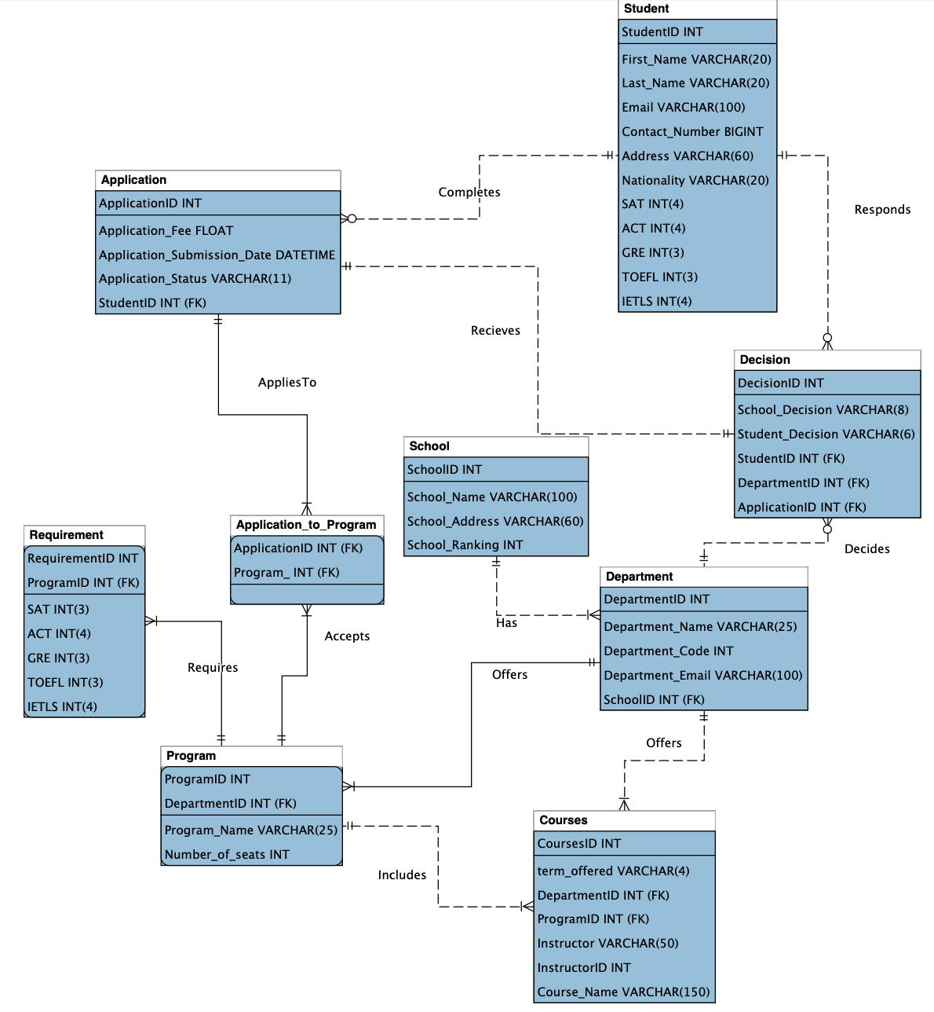
Logical Model
The logical model serves as the foundational framework for our Educational Database, providing a structured representation of entities, attributes, and relationships within the system

Slide 5
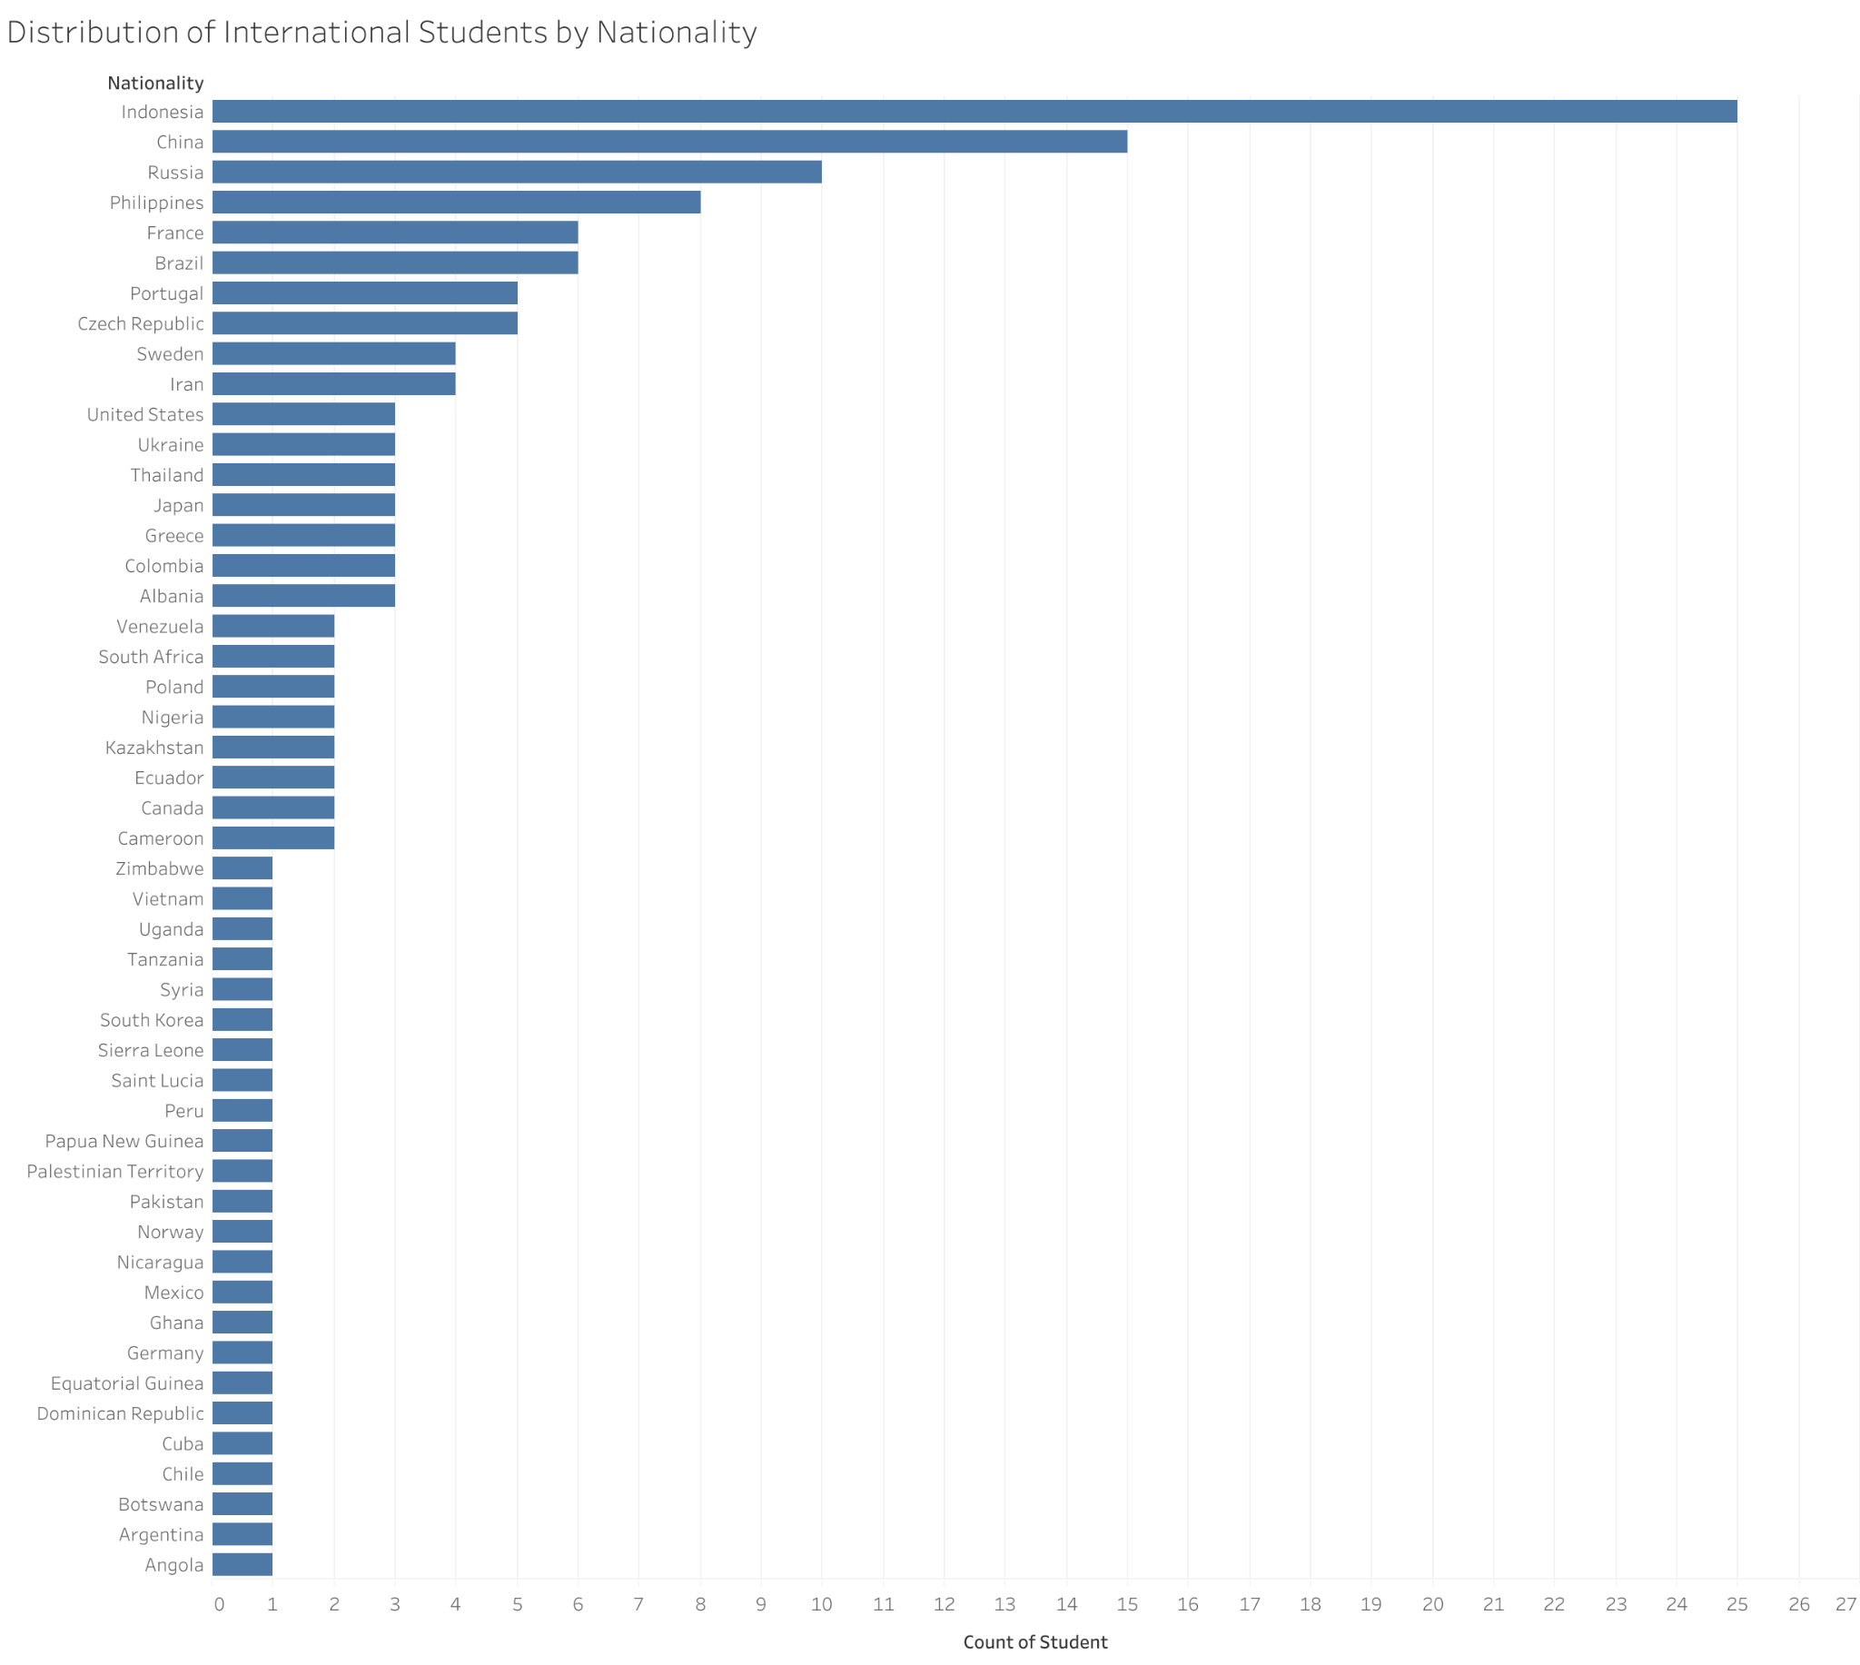
Distribution of International Students by Nationality
Notes:
This bar chart visualizes the distribution of international students in the U.S. by nationality. We can know that the highest number of international students come from indonesia at the top of the chart, which is significantly more compared to others.

Slide 6
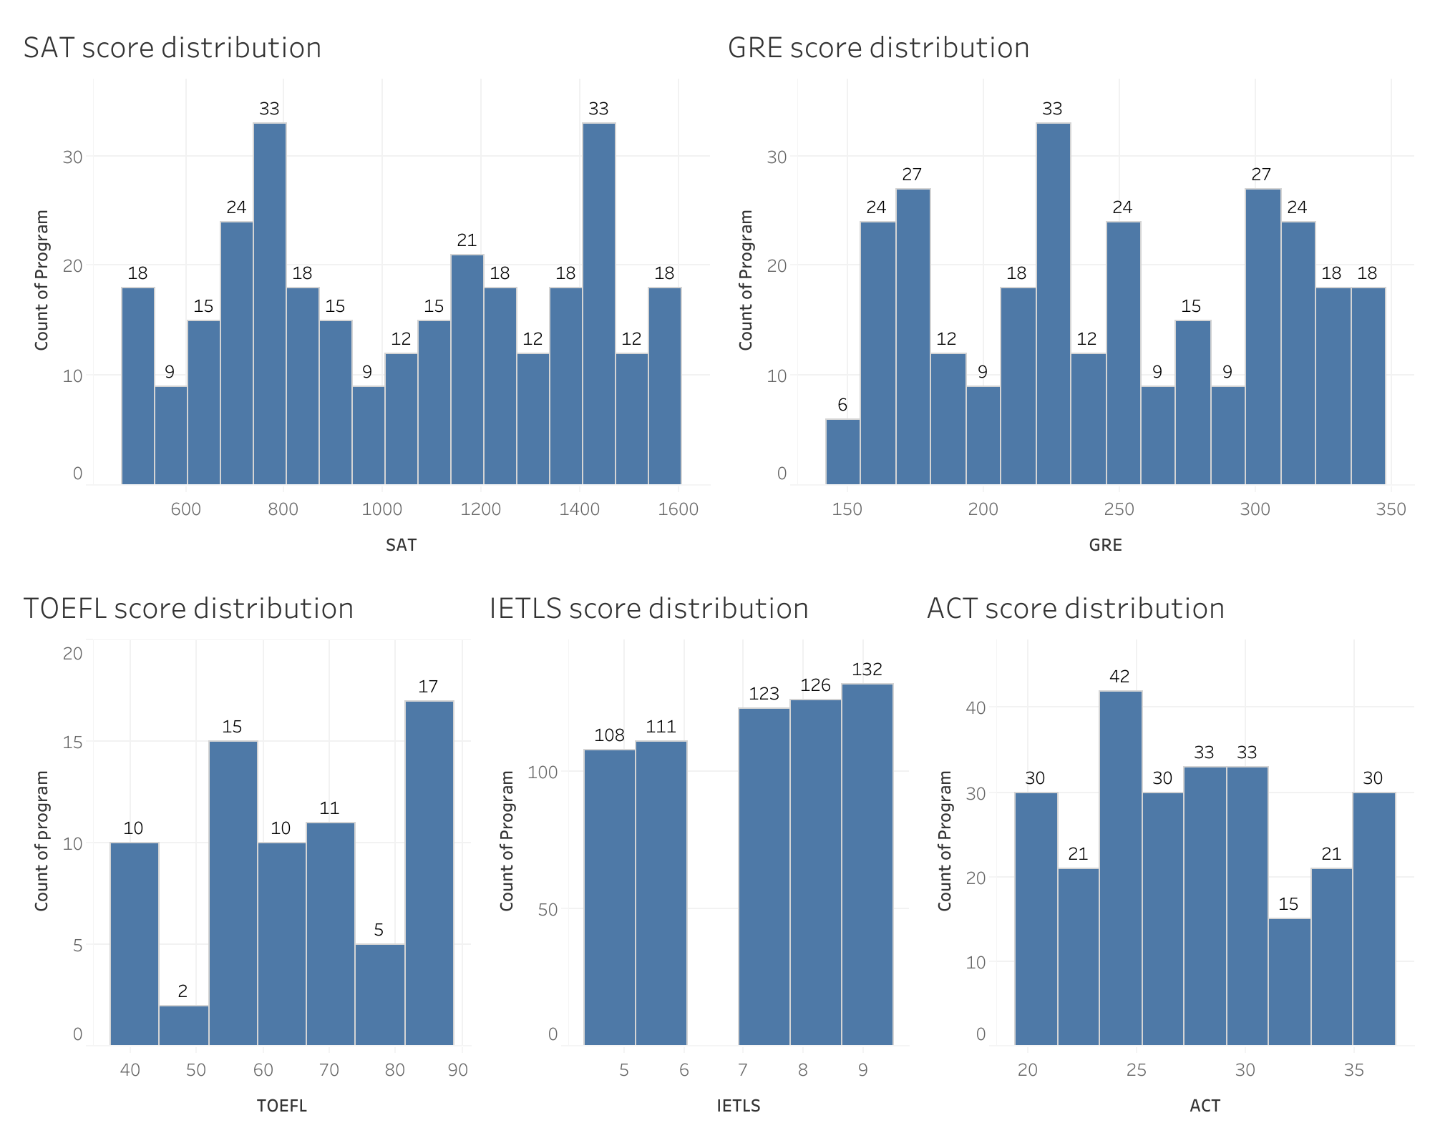
Distribution of Program Requirements for Various Scores
Notes:
The graph provides a benchmark for international students to aim for in their test preparations.

Slide 7
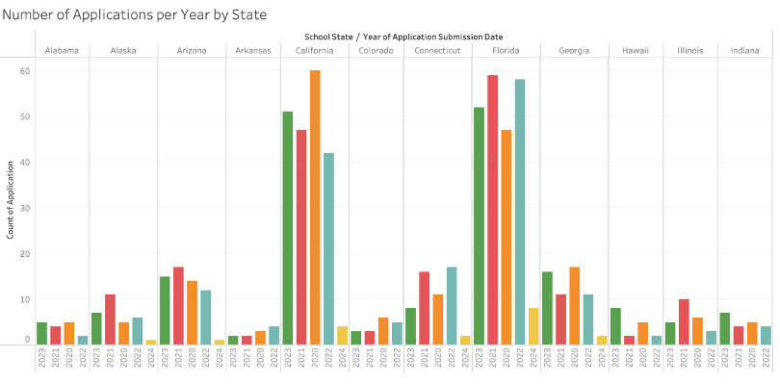
Notes:
The information gathered by the users of this database will help future students make decisions on where they want to apply. The following slides show the dashboard graphs of the number of applicants to each state. Depending on preference, a student could decide to apply where they will be among other international students, or they could choose to increase their chances of acceptance by applying to schools in states where there are less applicants.

Slide 8
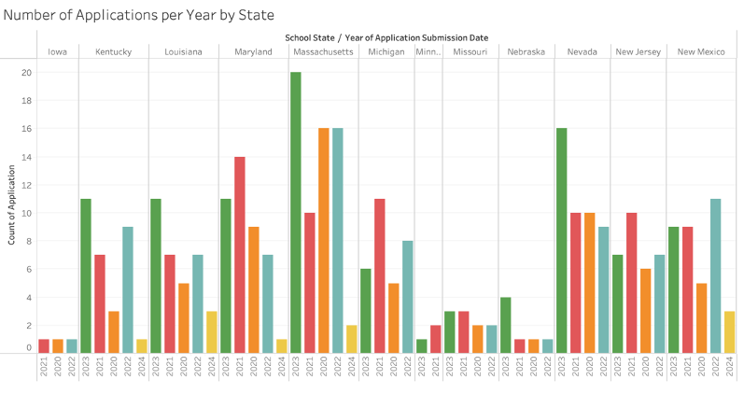

Slide 9
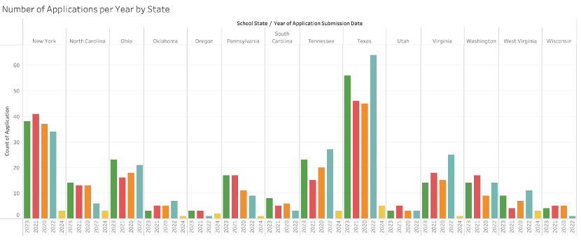

Slide 10
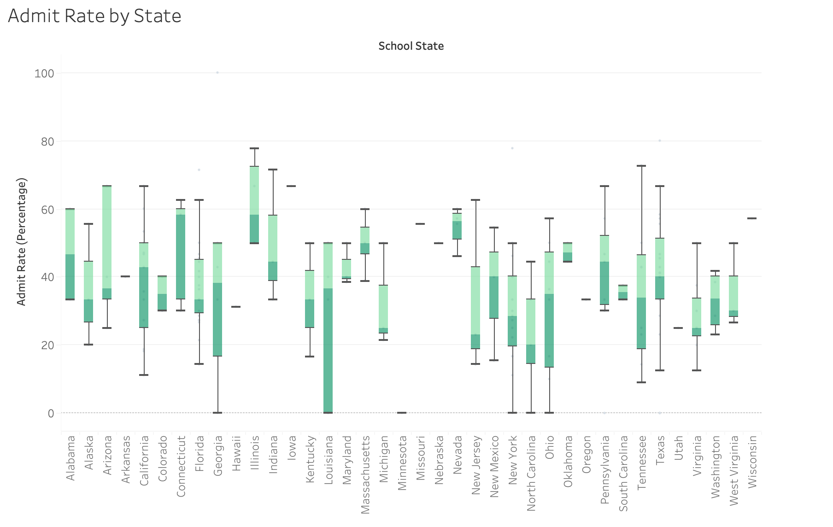
Notes:
An important feature that is available is acceptance rates by school for international students. Currently acceptance rates that are available on websites are not specific to international students, acceptance rates for international students are different then they are for the domestic students. Providing acceptance rates will help students adjust their application strategies. The more students utilize this tool the better these metrics will become.

Slide 11
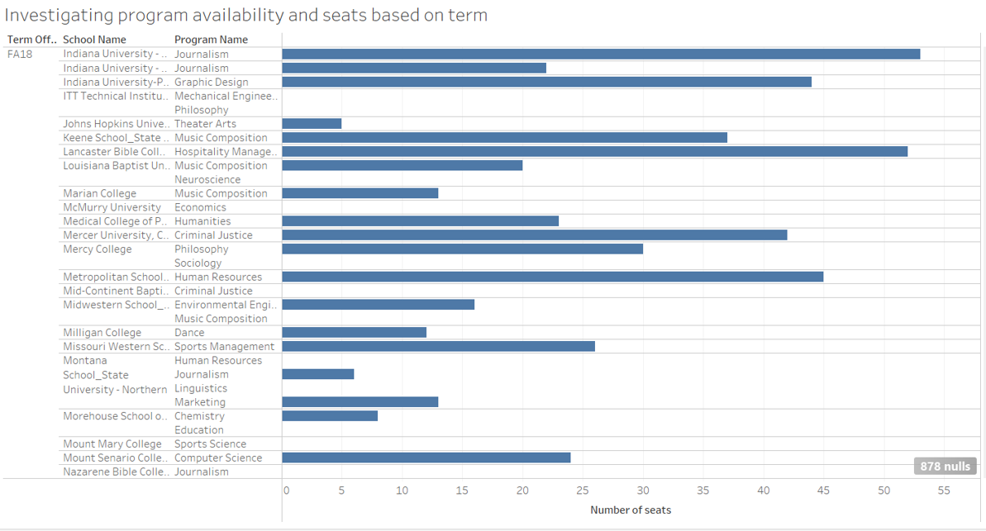

Slide 12
